Slide 1
LeNet Architecture on MINST Dataset

Slide 2
Dataset
Dataset: MNIST Handwritten Digits
60,000 training images
10,000 testing images
Image size: 28 × 28
Classes: 0–9

Slide 3
Import Libraries
import tensorflow as tf
from tensorflow.keras import layers, models
import matplotlib.pyplot as plt
import numpy as np

Slide 4
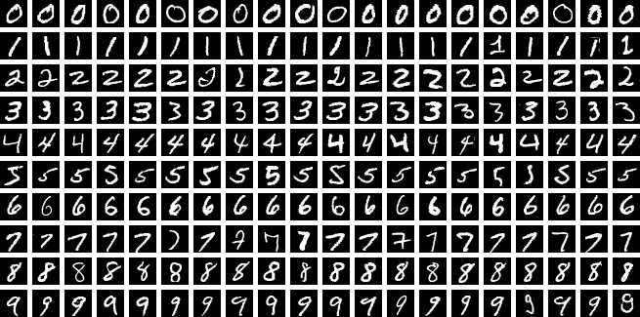
Load MNIST Dataset
(x_train, y_train), (x_test, y_test) = tf.keras.datasets.mnist.load_data()
print("Training data shape:", x_train.shape)
print("Testing data shape:", x_test.shape)

Slide 5
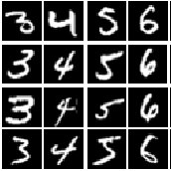
Visualize Sample Images
import matplotlib.pyplot as plt
plt.figure(figsize=(8, 4))
for i in range(8):
plt.subplot(2, 4, i + 1)
plt.imshow(x_train[i], cmap='gray')
plt.title(f"Label: {y_train[i]}")
plt.axis('off')
plt.tight_layout()
plt.show()

Slide 6
Data Preprocessing
# Normalize pixel values
x_train = x_train / 255.0
x_test = x_test / 255.0
# Reshape for CNN input
x_train = x_train.reshape(-1, 28, 28, 1)
x_test = x_test.reshape(-1, 28, 28, 1)

Slide 7
Basic CNN Architecture
Input (28×28×1)
→ Convolution
→ ReLU
→ Max Pooling
→ Flatten
→ Fully Connected Layer
→ Output (10 classes)

Slide 8
Define Basic CNN Model
model = models.Sequential([
layers.ZeroPadding2D(padding=(1, 1), input_shape=(28, 28, 1)),
layers.Conv2D(filters=8,
kernel_size=(3, 3),
activation='relu’,
input_shape=(30, 30, 1)),
layers.MaxPooling2D(pool_size=(2, 2), strides=(1, 1)),
layers.Flatten(),
layers.Dense(10, activation='softmax')
])
model.summary()

Slide 9
Compile the Model
model.compile(
optimizer='adam',
loss='sparse_categorical_crossentropy',
metrics=['accuracy']
)

Slide 10
Train the Model
history = model.fit(
x_train,
y_train,
epochs=5,
batch_size=64,
validation_split=0.1
)

Slide 11
Evaluate the Model
test_loss, test_accuracy = model.evaluate(x_test, y_test)
print(f"Test Accuracy: {test_accuracy * 100:.2f}%")

Slide 12
Assignment
Implement LeNet-5 on MINST dataset
Pad MNIST images from 28×28 to 32×32
Implement LeNet-5 architecture
Train the model
Model summary
Plot accuracy and loss graph

Slide 13
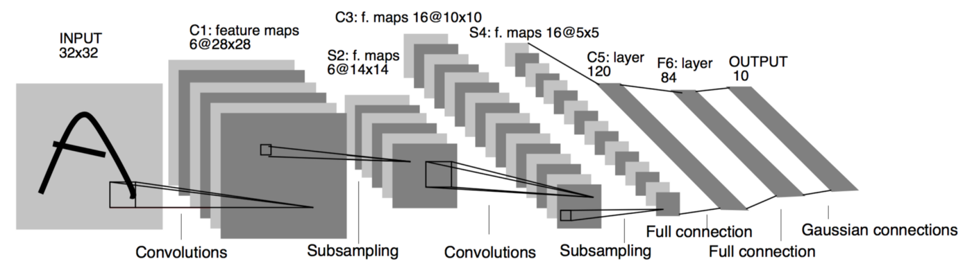
Assignment
Fig. LeNet Architecture

Slide 14
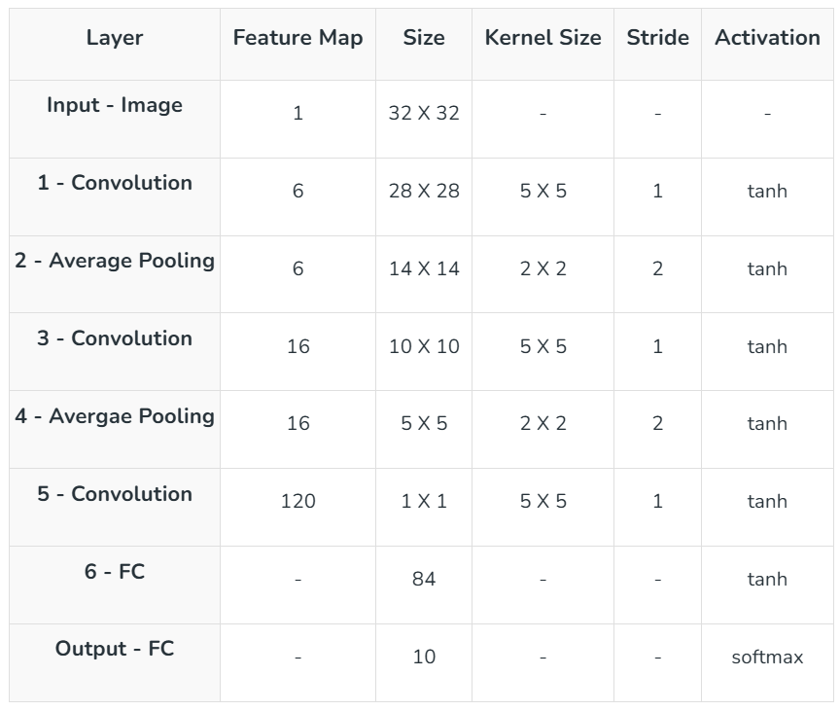
Assignment (Expected Output)
Model Summary

Slide 15
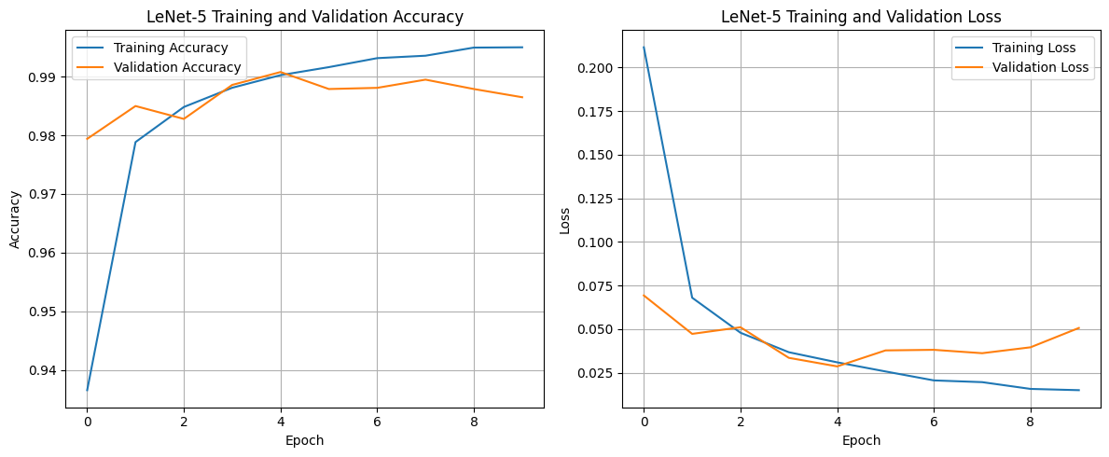
Assignment (Expected Output)
Accuracy and Loss graph (Acc > 98%)

